Slide 1



Medindo Tracker
one stop for your Health Assessment
Team Name- DeliHeist
by- Zaid Mohammad Zia and Pranav Gupta

Slide 2



1
Introduction
2
User Interface and Experience
3
Health Calculation Logic
Agenda
Health Facts Feature
4
Topics Covered
5
Code Highlights
6
Challenges and Solutions
7
Future Improvements
8
Conclusion

Slide 3

Problem Statement
Many people find it hard to keep track of their health because they lack simple tools to help them. Traditional health assessments can be complicated and often require a visit to a doctor, which makes it difficult for individuals to understand their health and take action.
Our project aims to solve this problem by creating an easy-to-use website where users can enter their health information. The website will calculate and show how healthy they are, providing personalized advice and resources.
By making health assessments simple and accessible, we hope to encourage people to take charge of their health and make better lifestyle choices.

Slide 4


Introduction
Objective-Our web app allows users to assess their health by analyzing their personal habits and lifestyle choices also providing a personalized health assessment and suggestions for improvement.
Key features-
Dark/Light mode switch for a user-friendly experience.
Interactive input form for personal health data.
Immediate feedback and health tips.

Slide 5
User Interface and Experience
Form Elements-Users can input their country, age, gender, BMI, exercise routine, sleep habits, smoking, and alcohol consumption.
Theme Toggle-
We provide a dark/light mode switch that ensures comfort for users in different lighting conditions.
We provide a dark/light mode switch that ensures comfort for users in different lighting conditions.
Loader and Pop-up-
1. A loading spinner gives feedback while processing data.
2.Results are displayed in a popup window for clarity and user focus.

Slide 6
Health Calculation Logic
Health Score Calculation:
1 . The app calculates a health score based on BMI, exercise, sleep, smoking, and alcohol consumption.
2 . It uses predefined conditions to determine if the user’s lifestyle choices are positive or negative.
Assessment Results:
1 . Based on the health score, the user receives a result like "Excellent Health" or "Poor Health."
2 . Tailored suggestions are provided for each factor (e.g., sleep, exercise).

Slide 7
Health Facts Feature
Random Health Tips:
1 . Our Website generates three random health tips from a list to encourage users toward healthier choices.
2 . Examples include "Stay hydrated" and "Get enough sunlight."

Slide 8
Code Highlights
Theme Toggle:
1 . JavaScript adds/removes the dark class to switch between light and dark mode.
Health Calculation:
Inputs are captured using get ElementById(), and then health score is calculated based on a set of conditions.
Example: If BMI > 29.9, the app returns a message that the user is obese and reduces the health score.
Results Display:
1 . The results popup is triggered after health score calculation, showing personalized health feedback.

Slide 9
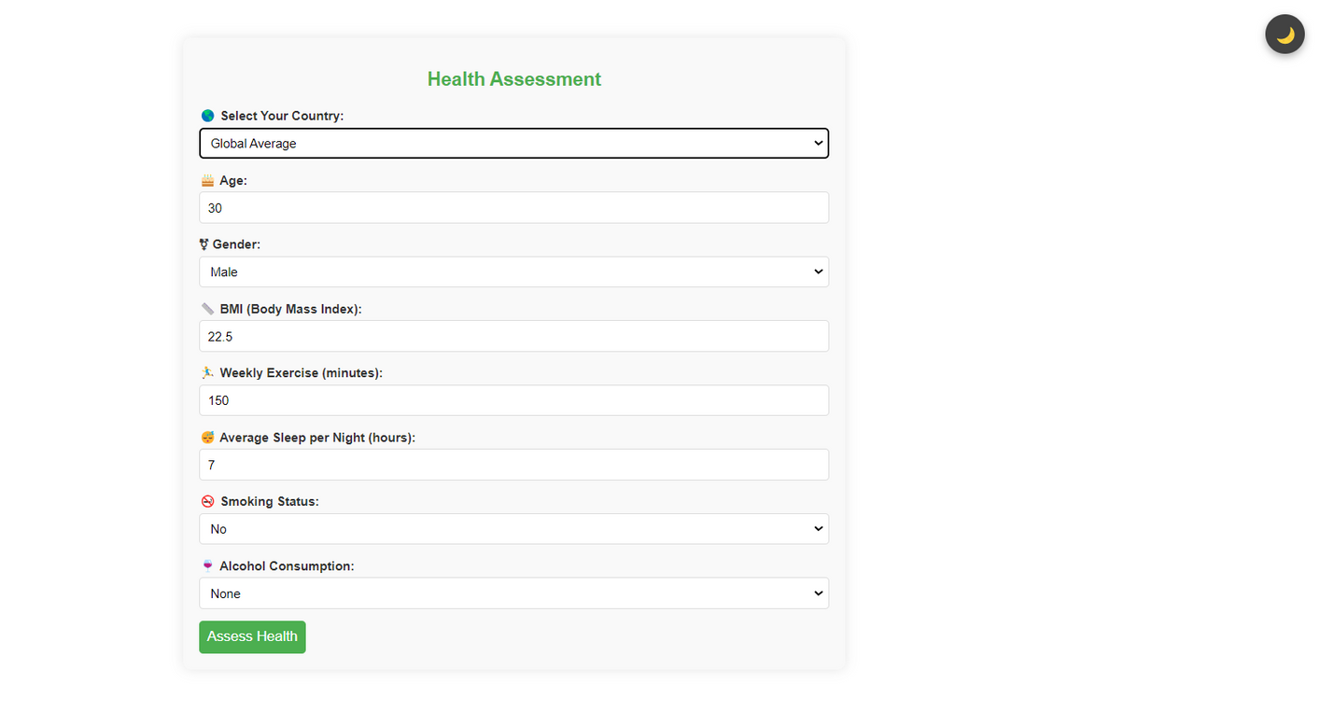
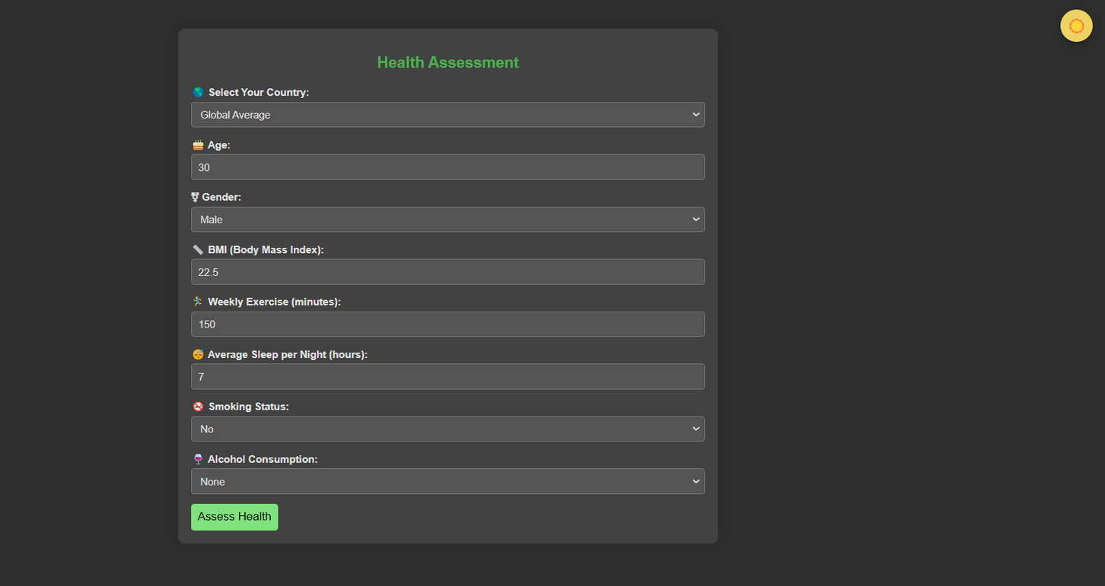

Slide 10
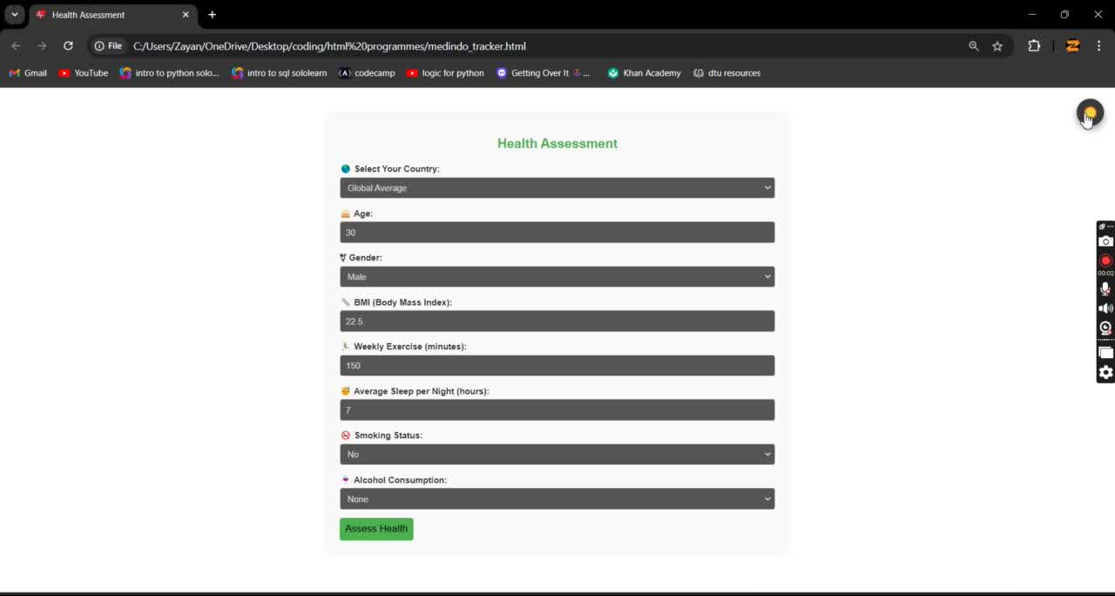

Slide 11
Challenges and Solutions
Challenge: Designing a responsive, user-friendly interface.
Solution: Added dark mode for better user interaction and created an intuitive form layout.
Challenge: Ensuring fast and accurate health assessments.
Solution: Optimized calculations using simple, effective JavaScript logic

Slide 12
Future Improvements
API Integration: Pull real-time health data after giving a set of instructions from the user.
Enhanced Analytics: Provide more personalized suggestions based on specific user data.
Mobile App: Create a mobile version for easier accessibility.

Slide 13



Thank you!
We’ve built a user-friendly, impactful tool to help people assess their health and make informed lifestyle decisions.
We believe our Website can empower users to take control of their well-being.

